Slide 1

PROFIT ANALYSIS USING REGRESSION
TEAM ID - PTID-CDA-JAN-26-1171
Presented By
M SARANYA
BOOMIKA K B
Capstone Project 1 – Profit Analysis

Slide 2
AGENDA
Project Objective
Attribute Information
Data Collection & Cleaning
Regression Analysis Approach
Power BI Dashboard & Visualizations
Key Insights & Business Recommendations
Conclusion

Slide 3
PROJECT OBJECTIVE
In this Dataset, Startups invest in different areas such as Research & Development, Administration, and Marketing to grow their business and increase profitability.
To study the impact of R&D Spend, Administration Spend, and Marketing Spend on Profit
To identify the key factors that contribute to higher profitability
To build a multiple linear regression model for profit prediction
To visualize trends and relationships using Power BI
To provide actionable insights and recommendations to improve business performance

Slide 4
ATTRIBUTE INFORMATION
R&D Spend – Investment in research and innovation
Administration Spend – Operational and management expenses
Marketing Spend – Cost spent on promotions and advertising
State – Location of the startup (categorical variable)
Profit – Net profit earned (target variable)

Slide 5
DATA COLLECTION & CLEANING
Data was extracted from a MySQL database using the provided credentials
The startup table was selected for analysis
Data was checked for missing values and inconsistencies
Column names and data types were verified
Cleaned data was used for regression analysis and visualization

Slide 6
REGRESSION ANALYSIS APPROACH
Multiple Linear Regression was used to analyze the relationship between spending and profit
Profit was considered as the dependent variable
R&D Spend, Administration Spend, and Marketing Spend were used as independent variables
The model was trained to understand the impact of each expense on profit
The regression model was used to predict profit for new input values

Slide 7
REGRESSION ANALYSIS OUTPUT
We use the Multiple Linear Regression formula to find Profit for the below-given input features.
Here
C | 50122.19299
m1 | 0.80571505
m2 | -0.026815968
m3 | 0.027228065
y = (m1​x1​)+(m2​x2​)+(m3​x3​)+c​
R&D Spend (x1) | Administration (x2) | Marketing Spend (x3) | Profit
21892.92 | 81910.77 | 164270.7 | ₹ 70,034
23940.93 | 96489.63 | 137001.1 | ₹ 70,554

Slide 8
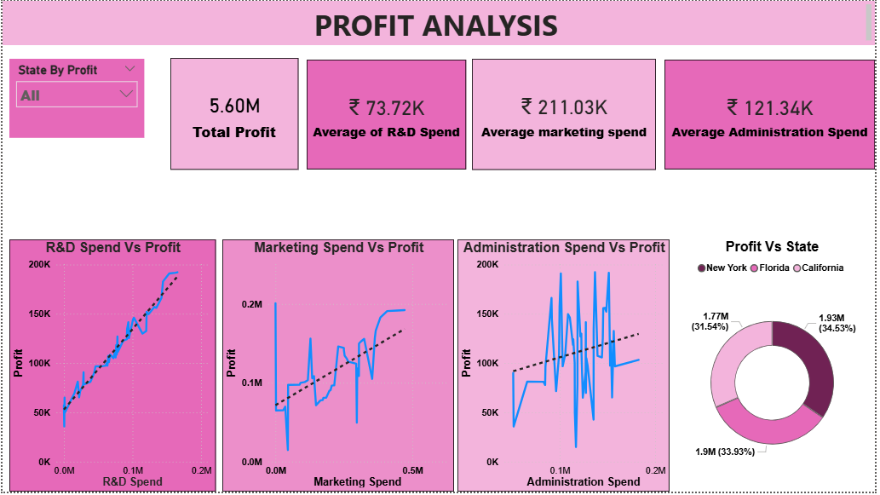
POWER BI DASHBOARD OVERVIEW

Slide 9
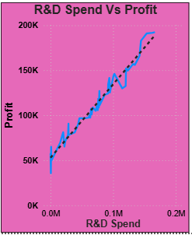
R&D SPEND Vs PROFIT
X-axis: R&D Spend
Y-axis: Profit
Each dot represents a state (California, Florida, New York)
The dotted trend line shows the overall relationship between R&D Spend and Profit
There is a strong positive relationship between R&D Spend and Profit
The upward trend line confirms that increasing R&D investment leads to higher profit

Slide 10
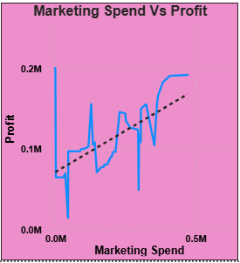
MARKETING SPEND Vs PROFIT
X-axis: Marketing Spend
Y-axis: Profit
Each point represents a state (California, Florida, New York)
The dotted trend line shows the overall relationship between Marketing Spend and Profit
The trend line indicates moderate growth in profit
Marketing spend improves profit, but returns reduce after a limit

Slide 11
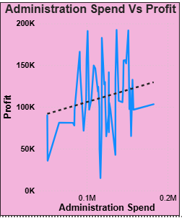
ADMINISTRATION SPEND Vs PROFIT
X-axis: Administration Spend
Y-axis: Profit
The dotted trend line represents the overall relationship between Administration Spend and Profit
The trend line is flat to slightly downward, indicating a weak or negative relationship
Excess administration spending can reduce net profit

Slide 12
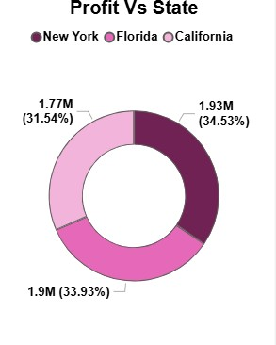
PROFIT Vs STATE
This is a donut chart showing profit contribution by state
Each segment represents the total profit generated by a state
Values are shown in millions (M) and percentage contribution
Profit contribution across states is fairly balanced, with slight variation

Slide 13
KEY INSIGHTS & BUSINESS RECOMMENDATIONS
R&D Spend is the strongest driver of profit. So, Increase investment in R&D to maximize profitability.
Marketing Spend has moderate impact with diminishing returns. Optimize marketing spend by focusing on high-ROI campaigns.
Administration Spend has minimal or negative impact on profit. Control and reduce administrative expenses to improve margins

Slide 14
CONCLUSION
By combining regression analysis with Power BI visualizations, this project demonstrates how identifying key profit drivers enables smarter investment decisions and sustainable business growth.
“Especially focused on R&D investment and cost optimization, can significantly improve startup profitability.”

Slide 15
THANK YOU

